Slide 1

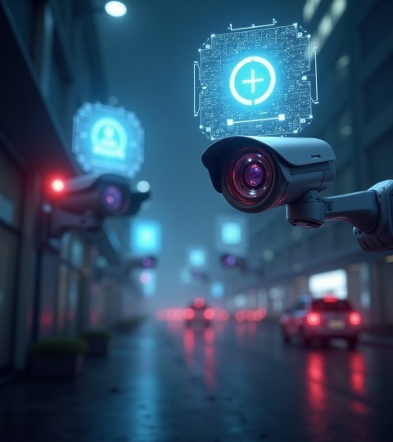
VisionIQ
An AI-Based Smart Surveillance System "See Smarter. Stay Safer."
VISION IQ'S TEAM -
Krishna Prasad - Team Lead Sriram - Team Member
Rishi - Team Member
Tarun - Team Member
Praneeth varma - Team Member
Pranay - Team Member

Slide 2
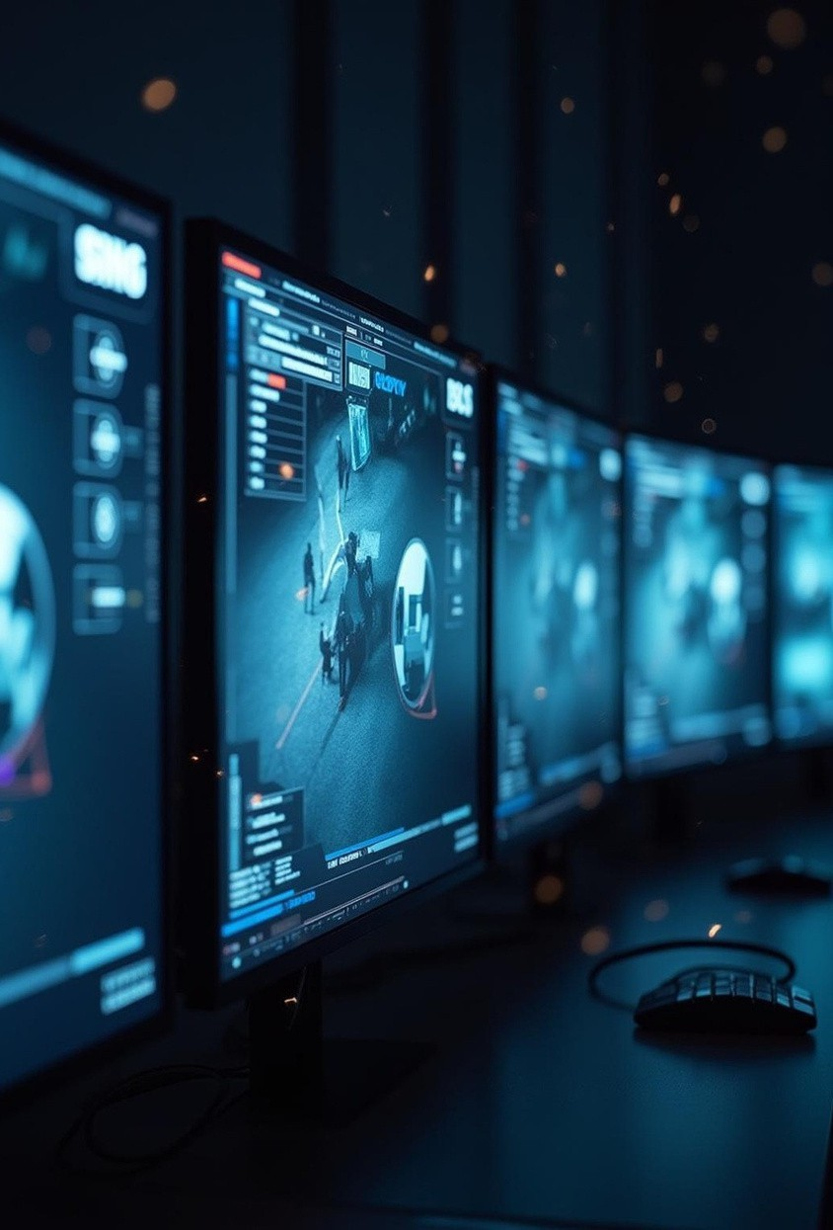
VISIONIQ
VisionIQ is an AI-based smart surveillance system that goes beyond traditional monitoring by integrating artificial intelligence to analyze and interpret visual data in real time. It uses computer vision and machine learning algorithms to detect unusual activities, identify potential threats, and send instant alerts to the concerned authorities.

Slide 3
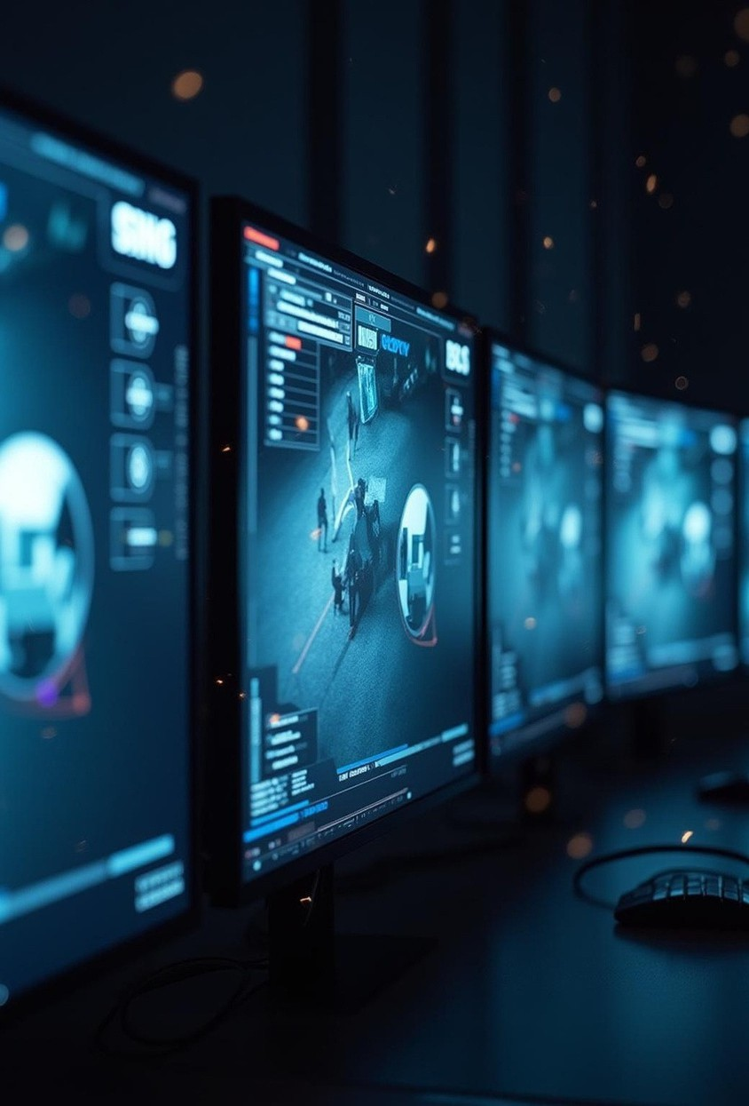
Introduction
Traditional CCTV systems are limited by their inability to analyze context, leading to numerous false alarms and generalized alerts. This presentation explores the key limitations of conventional CCTV and highlights the advantages of integrating AI for smarter, more precise security monitoring.

Slide 4
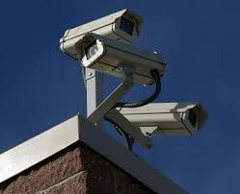
PROBLEM STATEMENT
Traditional CCTV systems:
Record everything but understand nothing.
Trigger alerts on simple motion.Treat 2 PM and 2 AM the same.
Overwhelm owners with false alarms.
Lack context awareness.

Slide 5
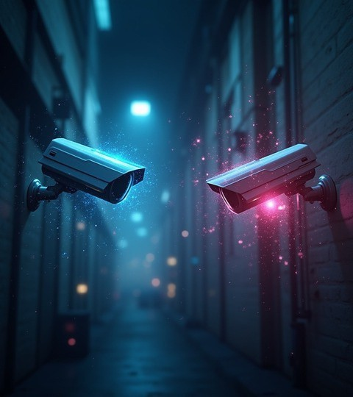
01
COMPLETE FEATURE SET

Slide 6

Person Detection & Property Mode Selection
Uses pretrained YOLO model.
Filters only the person class.
Ignores random motion (curtains, shadows, animals).
User can selects Home,Shop,Office Each mode activates different contextual rules.

Slide 7
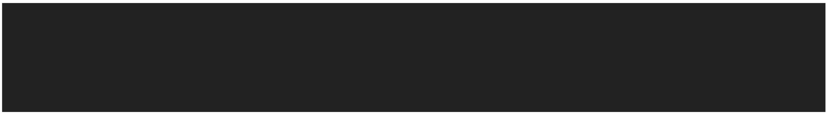

Operational Time Awareness & Person Count Monitoring
Operational Time Awareness & Person Count Monitoring
-User defines:
Opening time Closing time
System checks real-time clock.
-Person count
Counts number of detected persons.
Compares with expected limits. Flags unusual crowd size.

Slide 8
Context-Based Threat Scoring Engine & Tiered Alert System
Instead of binary alerts:
Dynamic score from 0–100.
Example scoring logic:
Person detected → +10
After-hours → +30
Restricted zone entry → +40
No activity → gradual decay
Score determines level. Score determines level.
Green-safe, Yellow-Suspicious, Red-Alert.

Slide 9

RESTRICTED ZONE MONITORING
Define a sensitive region in the camera frame. Examples:
Locker
Cash Counter Bedroom Door Main Entrance
If a person enters the defined zone, the
system detects the intrusion and triggers an alert.

Slide 10
01
Benefits of AI- based Smart CCTV

Slide 11
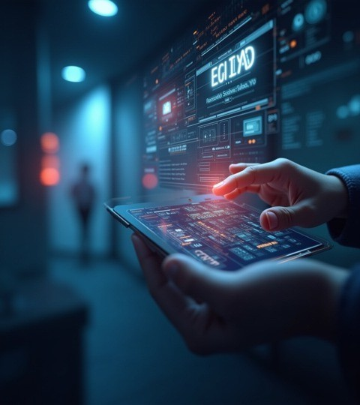
Reduces false motion alerts Detects only human activity Context-aware security monitoring Identifies night- time intrusions Monitors crowd size automatically Detects suspicious behavior (loitering) Identifies abandoned objects

Slide 12
Provides real-time threat scoring Prioritized alert system (Safe / Suspicious / Critical) Captures evidence snapshots automatically Enables real- time monitoring dashboard Reduces manual surveillance effort Improves overall security and safety

Slide 13

SYSTEM ARCHITECTURE
Camera
↓
OpenCV — captures frames
↓
YOLO11s — detects persons
↓
ByteTrack — tracks each person
↓
Motion Engine — running / panic / abandoned
↓
Context Engine — mode + time + zone + count
↓
Threat Score 0–100
↓
Safe / Suspicious / Critical
↓
FastAPI WebSocket
↓
Live Dashboard + MongoDB

Slide 14
AI Smart CCTV System – Working Process
Video Capture CCTV / Webcam / IP Camera captures live video and sends it to the system.
Frame Processing (OpenCV) Video is converted into frames so the AI model can analyze each image.
Person Detection (YOLO) The AI model detects only people and ignores irrelevant motion like shadows or animals.
Person Tracking (ByteTrack) Each detected person is given a unique ID and tracked across frames.
Context Analysis The system checks important factors: • Time of day • Property type (Home / Shop / Office) • Number of people • Restricted zone entry
Threat Scoring Engine All information is used to calculate a risk score from 0–100.
Alert Decision The system classifies activity as: 🟢 Safe | 🟡 Suspicious | 🔴 Critical
Real-Time Dashboard & Alerts Live video, threat score, and alerts are shown on the dashboard, and the owner receives notifications if a critical threat occurs.

Slide 15
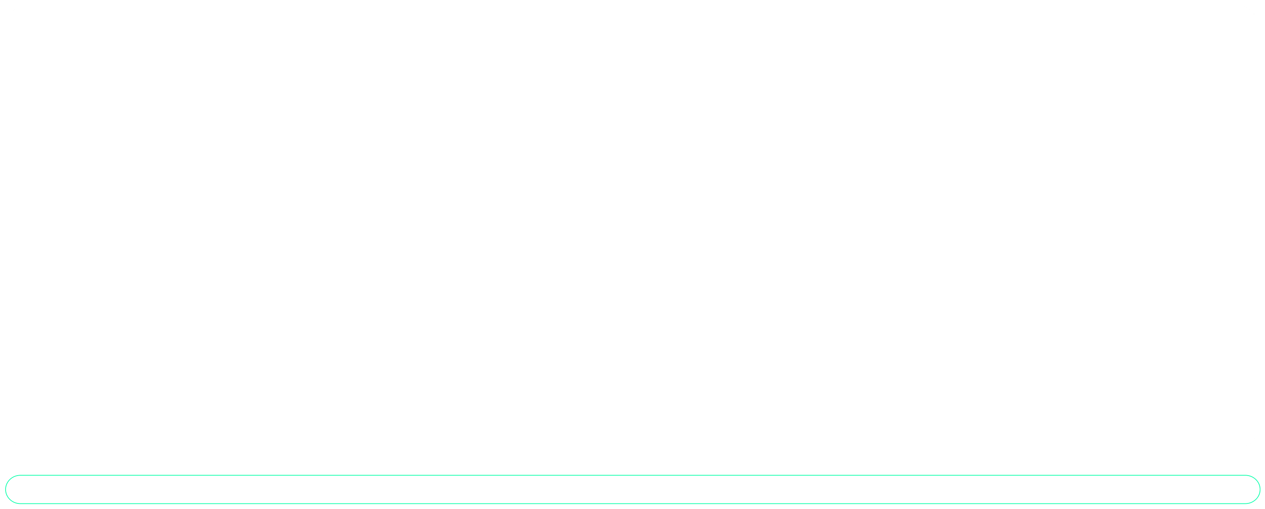
Enhanced security and operational efficiency
By integrating AI, smart CCTV systems optimize surveillance processes, lowering workload and costs. They provide actionable insights through real-time data analysis, enabling more informed decisions and stronger security management.

Slide 16
Two Deployment Models
Self Hosted
Customer has PC → installs our software → works offline → full privacy
Subscription
Customer has camera only → we run AI on cloud → works from phone → no setup

Slide 17
Hardware Requirements
Self Hosted - A personal computer that runs the model full time with the wifi all the time , that send the data to the frontend.
Subscription - The model runs on our servers that cameras feed is sent to the model to run that returns that data to the frontend.

Slide 18
Software Stack
AI Engine
Python · YOLO11s · ByteTrack · OpenCV · FastAPI · PyTorch CUDA Dashboard
Next.js · Tailwind · WebSocket · MongoDB · Vercel Why these tools
YOLO11s = fastest accurate detector · FastAPI = native WebSocket · MongoDB = flexible alerts · Next.js = instant deployment · WebSocket = zero delay streaming

Slide 19
Conclusions
The AI-Based Smart CCTV System improves traditional surveillance by adding intelligence and context awareness. Instead of only recording video, the system detects people, analyzes behavior, and evaluates threats in real time. Features like person detection, threat scoring, restricted zone monitoring, loitering detection, and smart alerts help reduce false alarms and improve security. Overall, this system provides smarter, faster, and more reliable surveillance, helping homes, shops, and offices respond quickly to potential threats and maintain a safer environment.

Slide 20
THANKS!

